Slide 1
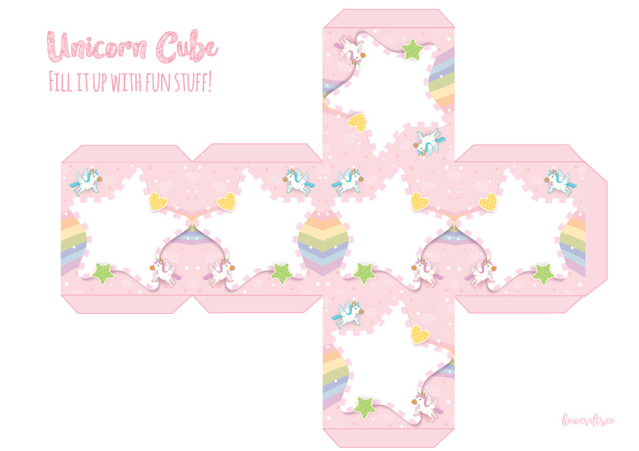
A
B
E
G
F
Step 1:
Customise the letters on the Cube.
Game Tip:
Let your kids decide what letters they want to play!
Feel free to change the Bonus Box →
Bonus +1

Slide 2
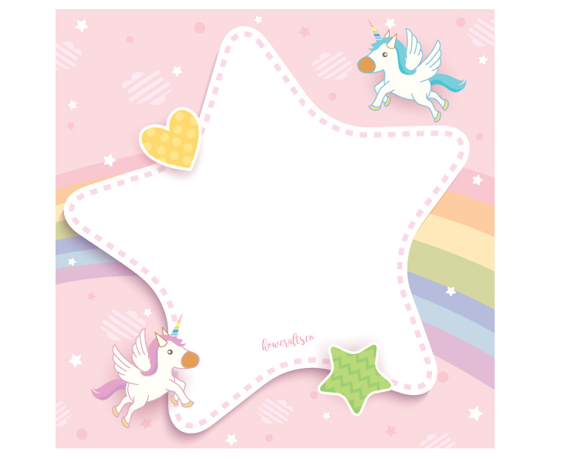
Step 2:
Customise the text and prize.
You may cut this out and insert this into the box as a surprise!
Great Job!
You are the winner!
And your prize is….
AN UNICORN ICE-CREAM!

Slide 3
S C O R E C A R D
Name 1
Name 2
Name 3
Name 4
TOTAL:

Slide 4
To Play
Suitable for kids aged 5 to 10
Preparation:
Involve your kids to prepare the cube for the gameplay.
How to play:
Each player is to roll the cube. They are to give a word that starts with the letter shown on the cube they rolled.
Parent can enforce a time limit per turn to ensure the game is fair and that the kids do not hog their turn for too long.
Give them clues e.g.
Look around the house. You can see an item that start with the letter ___. It’s blue in color (describe)
Describe a verb/adjective/thing for them to guess.
Have the older kids help the younger ones with clues.
Keep score using the score card. (+1 per correct answer).
Winner with the most points win the mysterious gift you have prepared!

